Slide 1




PREDICT DEFAULTS
PROTECT MARGINS
Dinesh Saraswat
Garima Vijay
Vinmathi Iyappan

Slide 2

SBA LOANS & SMALL BUSINESSES
Significance of Small Businesses: Vital for U.S. job creation and economic growth, supported by SBA's loan guarantee program.
Risk Exposure: Despite SBA guarantees, banks face significant risks from loan defaults
Regulatory Context: Basel III mandates accurate Probability of Default (PD) estimation for regulatory compliance and financial stability.
Key Challenges:
High Risk
Uncertainty
Regulatory Pressure
Notes:
Let's get started with the overview
Small businesses are the backbone of the U.S. economy, and the SBA supports them through loan guarantee programs.
However, financial institutions still face risks for the uncovered portion of loans, along with the need to meet strict regulatory compliance for financial stability.
Key challenges include managing high capital risk, navigating market uncertainties, and adhering to regulatory pressures while ensuring continued support for small businesses.

Slide 3

APPROACH TO OPTIMIZE LOAN APPROVAL
Identifying Relevant variable :
Prioritize variables with significant impact on loan repayment behavior.
Cost-Sensitive Machine Learning Model:
Minimize misclassification of high-risk loans as low risk.
Goal: Maximize overall bank returns.
Optimise Loan Approval:
Identify the optimal cut-off probability for loan approval decisions
Balance default risk with potential returns.
Align cut-off probability with business goals to maximize profitability.
Notes:
To improve loan decisions, we first prioritize variables that significantly impact repayment behavior, ensuring our model focuses on the most relevant predictors.
Next, we use a cost-sensitive machine learning model to minimize the misclassification of high-risk loans, aiming to maximize overall bank returns.
Finally, we optimize the cut-off probability for approvals, striking a balance between default risks and returns, aligning with business goals to ensure profitability.

Slide 4
ABOUT THE DATA
SBA National Data
Time Period 1987-2014. Observations 899,164 Variables 27
Variable Name | Data Type | Description
LoanNr_ChkDgt | Text | Identifier-Primary KeyAlign cut-off probability with business goals to maximize profitability.
Name | Text | Borrower Name
City | Text | Borrower City
State | Text | Borrower State
Zip | Text | Borrower Zip Code
Bank | Text | Bank Name
BankState | Text | Bank State
NAICS | Text | North American Industry Classification System code
ApprovalDate | Date/Time | Date SBA Commitment Issued
ApprovalFY | Text | Fiscal Year of Commitment
Term | Number | Loan term in months
NoEmp | Number | Number of Business Employees
NewExist | Text | 1= Existing Business, 2 = New Business
Variable Name | Data Type | Description
CreateJob | Number | Number of jobs created
RetainedJob | Number | Number of jobs retained
FranchiseCode | Text | Franchise Code 00000 or 00001 = No Franchise
UrbanRural | Text | 1= Urban, 2= Rural, 0 = Undefined
RevLineCr | Text | Revolving Line of Credit: Y = Yes
LowDoc | Text | LowDoc Loan Program: Y = Yes, N = No
ChgOffDate | Date/Time | The date when a loan is declared to be in default
DisbursementDate | Date/Time | Disbursement Date
DisbursementGross | Currency | Amount Disbursed
BalanceGross | Currency | Gross amount outstanding
MIS_Status | Text | Loan Status, “CHGOFF”(defaulted) or “PIF” (paid in full)
ChgOffPrinGr | Currency | Charged- off Amount
GrAppv | Curency | Gross Amount of Loan Approved by Bank
Notes:
About the SBA National Data.
Data had loan information backed by SBA from 1987 to 2014 with observation of approx 900K with 27 variables.
MIS_Status is one variable we are interested in predicting if it charged off i.e. defaulted or is it paid in full.
Other demographic, financial and business details are also captured in the dataset.

Slide 5
DATASET LIMITATIONS
Outdated dataset :
The span of years data covers (1987 to 2014) might limit the applicability of insights to current business contexts, as patterns and behaviors could have changed over time.
Data Entry Errors
Several variables (including RevLineCr, City, ZipCode etc.) had errors in data entry
Data Inconsistencies

Slide 6
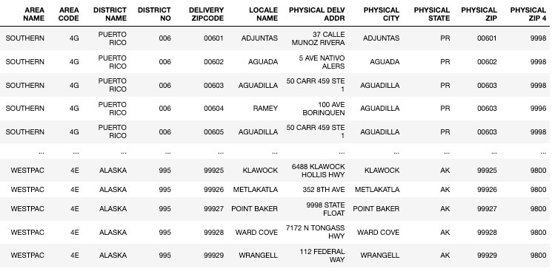
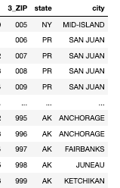
THIRD PARTY DATA
3 –Digit Zip Code (3-Digit-Zip-code-USPS)
ZIPCODE details (ZIPCODE_data_USPS)
Notes:
Third Party data we have gathered form USPS website to map the geography information for business such as city and state.
Here is the sample data snapshot post ingestion in dataframe

Slide 7
DATA CLEANING
Attribute | Correction/Update Steps | Action
MIS_STATUS | Dropped records with null values for MIS_STATUS | Drop
BankState, DisbursementDate, State, City | Drop NA records | Drop
NAICS | Prefixed with 0 where length is less than 2. Filled NA values with the mode of industry for each state. | Fill/Replace
NewExist | Filled the missing value with 0 | Fill
ApprovalFy | Replaced non-numeric values | Replace
BalanceGross, DisbursementGross, ChgOffPrinGr, GrApprv, SBAAppv | Replaced non-numeric values | Replace
Zip | Prefix with '0' for 4 lengths zips. And correct the ZIPCODE for cities and states whose ZIP lengths are less than 3 from the USPS data | Replace/Update
RevLineCr | Has some inconsistent data entries. Replaced the values closer to 1 or Y on Qwerty keyboard with 1 and values closer to 0, N and null as 0 | Replace/Update
City | Fixed Cities data based on ZIP matches from USICS data (replaced city and bad street data) | Third Party Update
State | Corrected State information based on ZIP Code | Third Party Update
Zip | Drop records who still does not have correct zip | Third Party Update
Low_Doc | Updated the flag based on the business rule , 1 if value <=150,000 | Update
Term | Values less than 6 seems incorrect. So, we lower ceiled default value to 6 minimum | Update
Notes:
Data cleaning was classified with actions to drop bad records and replace and fill any inforamtion if we can .
ZIP was replaced with the help of 3rd party data by identifying the correct zips for city and states whose zips were wrong, i.e. zip as <-3 length. And then mapping the city and state based on the 5 length zipcodes.
Term was updated to ceil at minimum value of 6 months, 0 term loans are impractical and suggest data entry error.

Slide 8
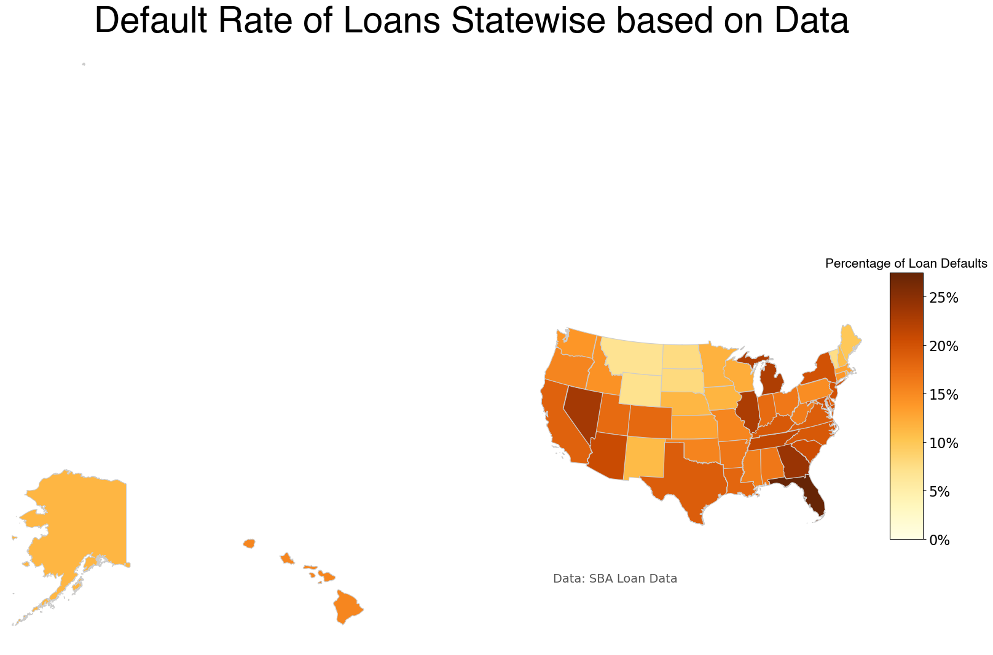
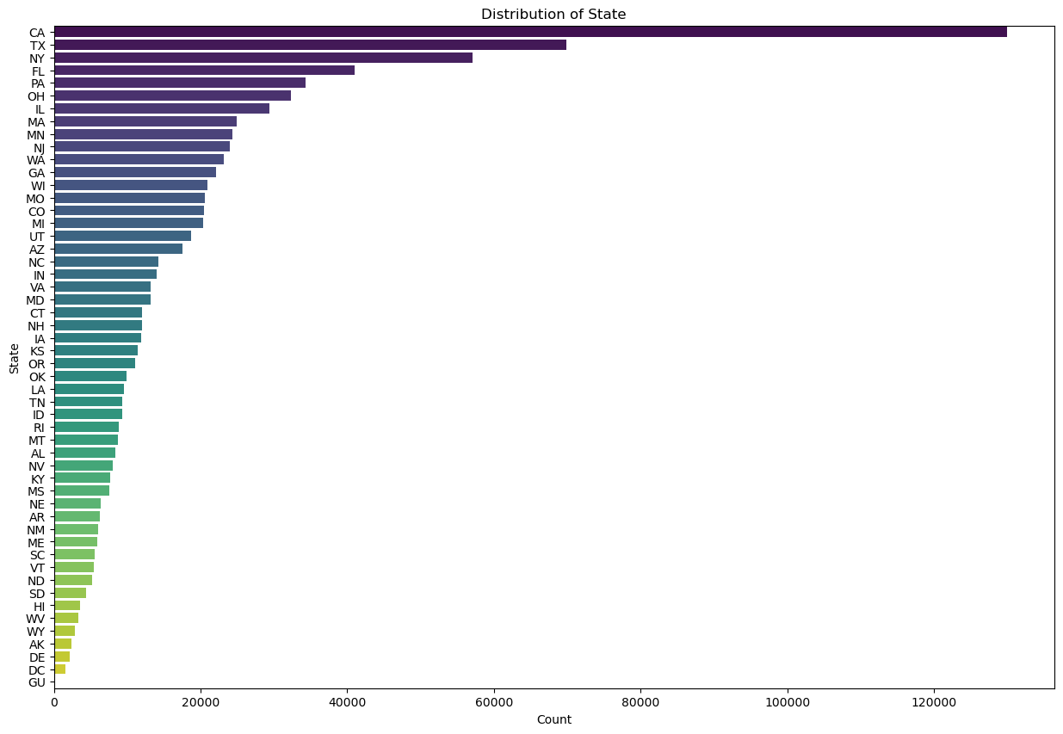
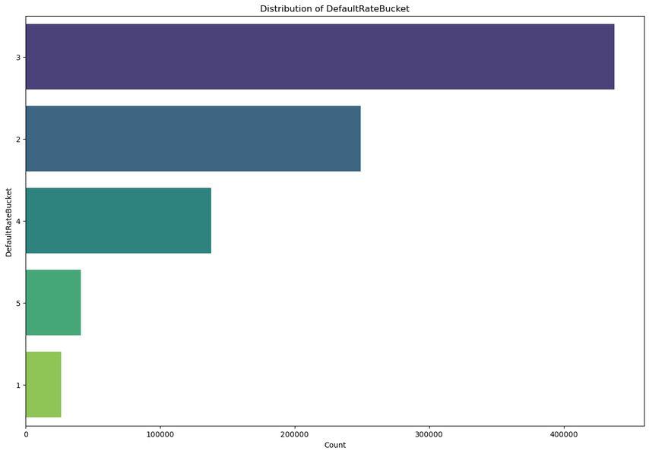
EXPLORATORY DATA ANALYSIS
Default rate
State
Default
Notes:
As part of EDA, one column that drew our attention was STATE.
If you notice the STATE data the percentage of loan default varies from State to state and the number of loans procured statewise.
We categorized those states based on the default rate from 1-5 in higher order of loan defaults. As you can notice. 2-4 covers the maximum loan disbursenebr i.e. default rate from 10-25%

Slide 9
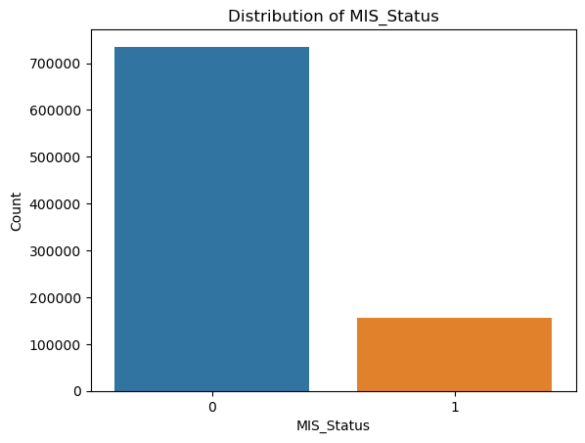
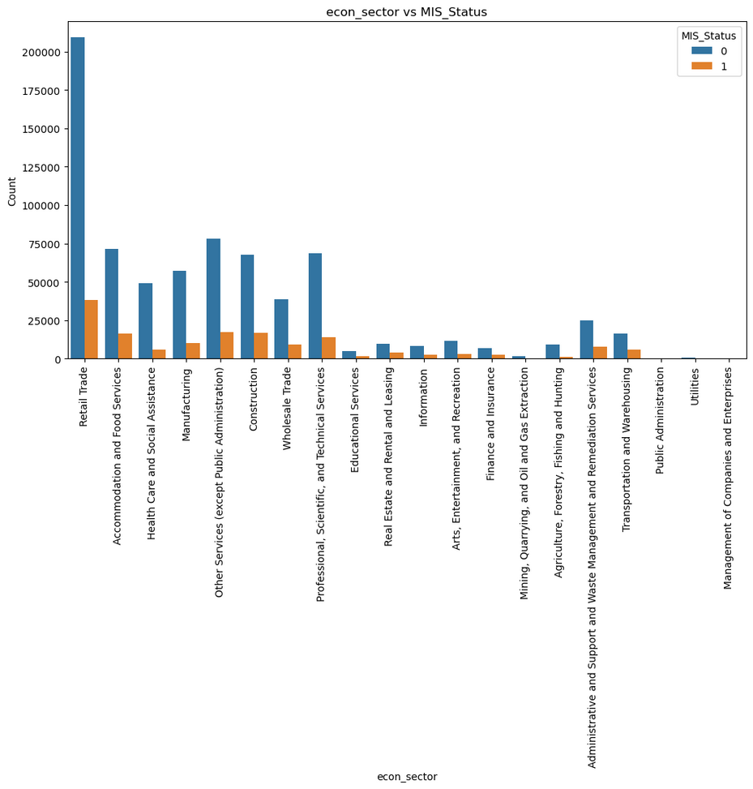
EXPLORATORY DATA ANALYSIS
MIS_Status
Economic Sector
Notes:
MIS_STATUS shows imbalance of default data as only 17% approx are defaulters.
This could be because all the loan might have been considered low_risk on day 1 while disbursing loans and over the time turned out to be default to multiple reasons.
We also have economic sector distrubution susggeting only few have good data representation. Hence we categorized all the industries in 1 buckt other than top 6

Slide 10
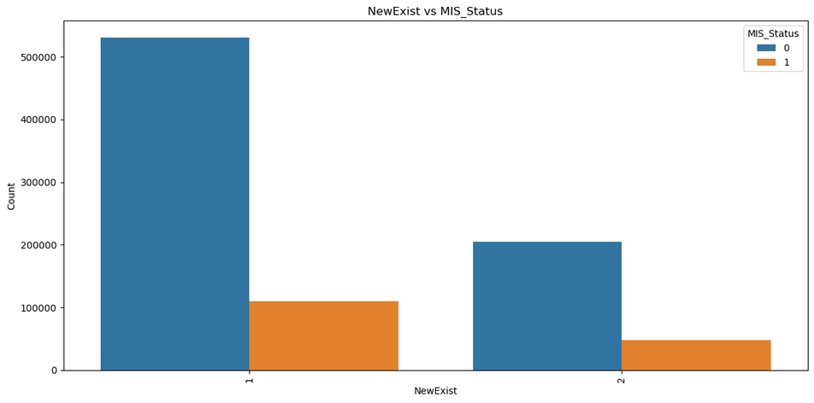
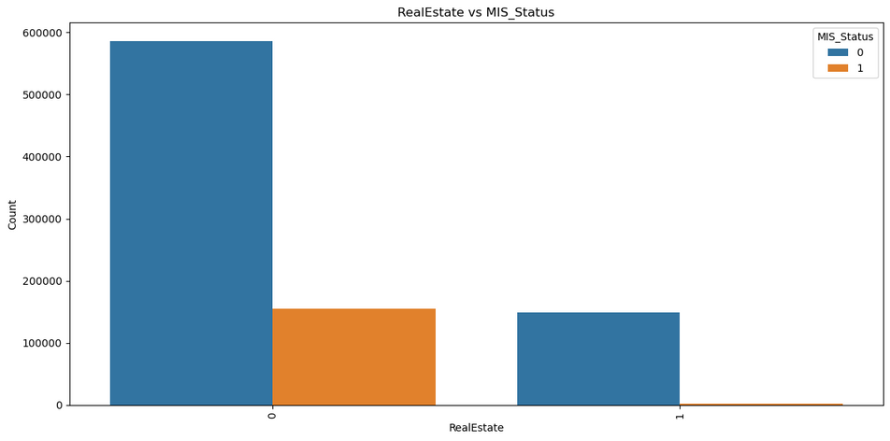
EXPLORATORY DATA ANALYSIS
NewExist
RealEstate Backed
Notes:
New business seem to apply for more loans then existing businesses. While real estate backed loan number are less still the percentage of paid is full is real high

Slide 11
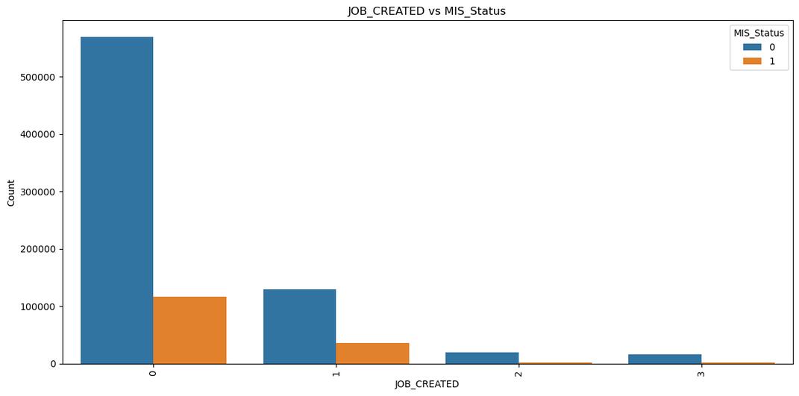
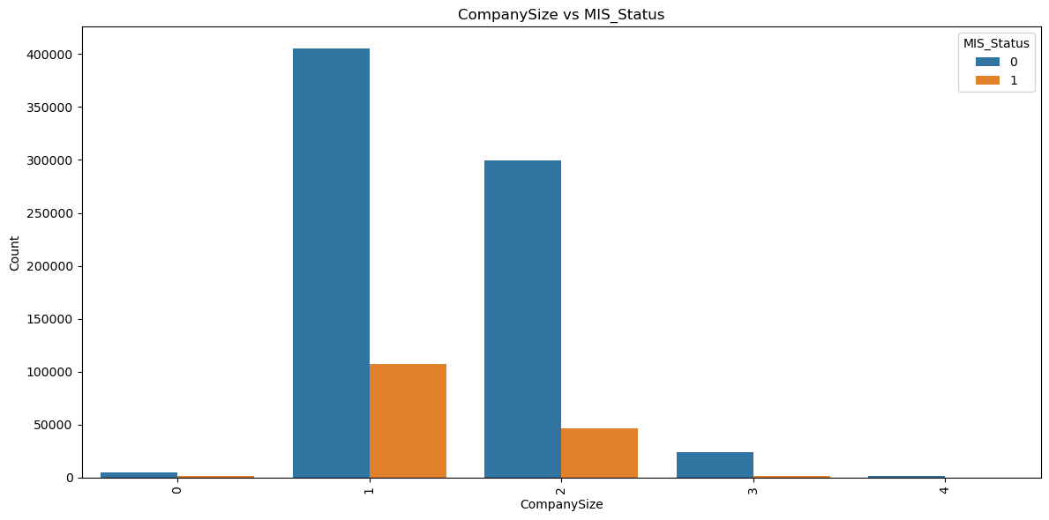
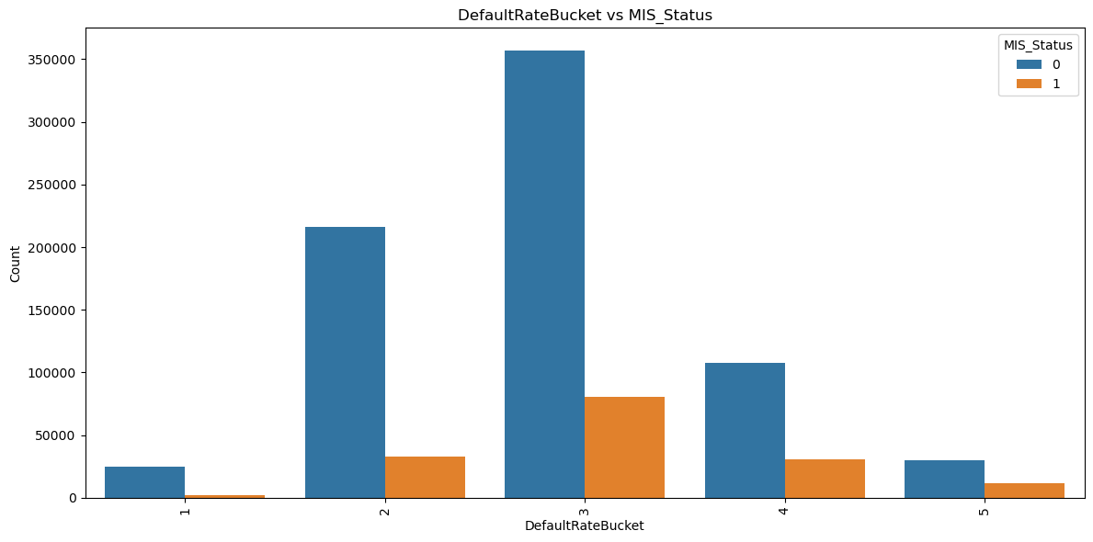
EXPLORATORY DATA ANALYSIS
Job Created
0-1 then 0, 2-10 then 1 , 11-20 then 2 else 3
Company Size
DefaultRateBucket
1-5 as 1, 6-50 as 2, 51-250 as 3 , 250 or more as 4
Notes:
Company Size of 1-50 have the significant presence in the data set. While Job created also <10 has major data presence.
Default rate bucket as shown earlier suggests 10-20% has the maximum presence in the dataset

Slide 12
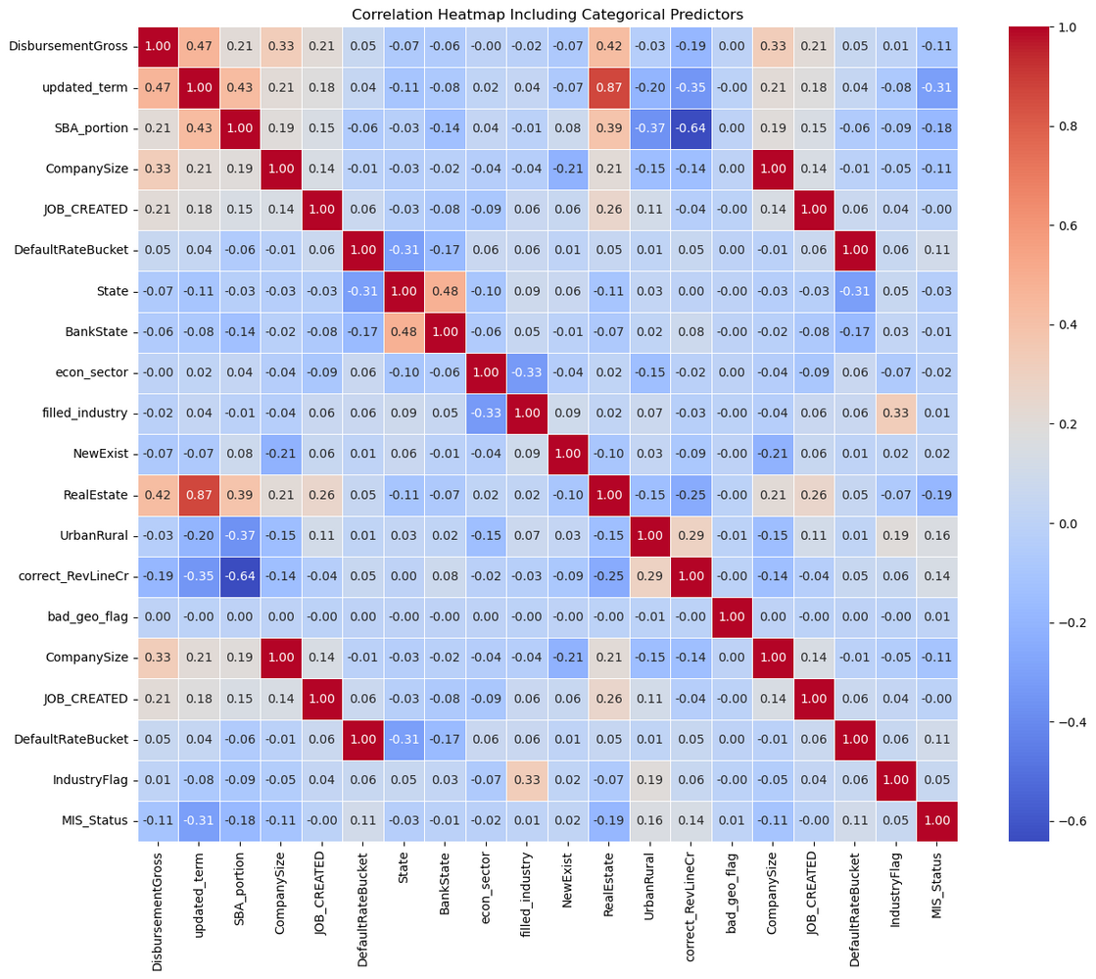
CORRELATION MATRIX
MIS_Status does not have significant correlation with any other variable
Notes:
Term is correlated to MIS_Status such that more is the duration of term high likely it should be paid
ALSO high SBA portion percentage ensure loans are not defaulted shown with correlation of 0.19
REal Estate back loans also shows good correlation.
SBA portion and real estate have mutual correlation of 0.39 shows that they are multiollinear and suggest that SBA may guarantee higher portion because its guranteed by real estate

Slide 13
FEATURE ENGINEERING
New Features | Rule
IndustryFlag | If the industry does not fall within the top 6 based on count, categorize it as "Other"; otherwise, retain its original value (44, 81, 72, 23, 54, 62)
Recession_Flag | If the loan was active during recession period of Dec 2007 to June 2009, then 1 else 0
RealEstate | If term >=240 then 1 else 0
SBA_Portion | (SBA_Appv/GrAppv)*100
If_Franchise | If the FranchiseCode is not 0 or 1, assign it a value of 1; otherwise, assign it a value of 0
DefaultRateBucket | States classification based on the percentage of loan defaults from each state. Values from Range of 1-5 for categories of loan default.
Company Size | Classify company based on size on range from 0-4 with no employees as 0, 1-5 as 1, 6-50 as 2, 51-250 as 3 and more than that as 4
Job_Created | if job_created 0-1 then 0, 2-10 then 1 , 11-20 then 2 else 3
Notes:
As part of the feature engineering we have incorporated the learning from EDA and created new flags and buckets based on Industry, Recession, Real Estate backed, SBA portion

Slide 14

FEATURE SELECTION
Excluded non-influential variables:
Name, City, Zip, Bank, BankState, ApprovalDate, ApprovalFY, ChgOffDate, Disbursement Date, Balance Gross, ChgOffPrinGr, Retained Job
Used Feature engineered Variables
Selected 14 variables as our final features:
Focused on variables with high predictive power:
Borrower Profile: New Exist, Company Size, If_Franchise.
Loan Details: Term, Disbursement Gross, SBA Portion, Default Rate Bucket.
Economic Context: Recession, Industry, Real Estate.
Operational Insights: Job Created, LowDoc, RevLineCr.

Slide 15
DATA SAMPLING AND PREPARATION
Stratified Sampling:
Addressed class imbalance effectively: PIF (Paid in Full): 85% Charged-Off: 15%
Feature Transformations:
Log Transformation: updated_term, DisbursementGross.
Label Encoding: IndustryFlag, CompanySize, DefaultRateBucket
One-Hot Encoding: NewExist, UrbanRural.
Quantile Transformation: SBA_portion.
Pass through: Recession, RealEstate, LowDoc_correct, correct_RevLineCr, If_Franchise, JOB_CREATED.
Train-Test Split
Split ratio: 80% training | 20% testing.
Training : (70,237, 14)
Testing : (17,560, 14)

Slide 16
TUNING THRESHOLDS WITH BUSINESS METRICS
Business Metrics:
Optimizes loan approval thresholds to maximize net profit
​
Used as the scoring function for threshold optimization in models.​
business_scorer = make_scorer(business_metric).set_score_request(disbursement_gross=True)
Baseline:
Benefit of approving all loans : $3,537.40 average net profit.
Benefit of rejecting all loans : $0 average net profit.
Predicted(decision) | Actual​ Paid in Full | Actual​ Default
Default | 0 | 0
Paid in Full | 5% of disbursement gross​ | -5 times of 5% of disbursement gross​

Slide 17
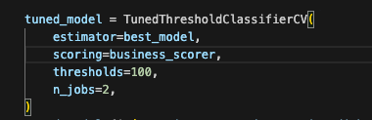
MODEL DEVELOPMENT - SUMMARY
Model:
Ran 10 models in this analysis
Used class weights {0: 1, 1:5} to address the class imbalance in our dataset
Handle the cost-sensitivity
Hyperparameter Tuning
Used Grid Search to optimize model parameters
Improved model performance through systematic parameter adjustment.
Calculated average profit using default threshold of 0.5.
Threshold Tuning
Applied TunedThresholdCV and Make_Scorer from Scikit-Learn
Determined optimal cut-off probability.
Focused on maximizing business profit by balancing precision, recall, and profitability.
Final Model
Selected the model with maximum average net profit as the final model.
Evaluated total profits and selected an optimal cut-off probability

Slide 18
MODEL COMPARISON
Model | ROC-AUC | Accuracy | Sensitivity | Precision | Specificity | Average profit (0.5 threshold) | Average profit ($, tuned threshold)
Logistic regression (class weights) | 0.800 | 0.799 | 0.794 | 0.453 | 0.800 | 5,637.720 | 5,674.800
Logistic regression (Elastic net) | 0.790 | 0.779 | 0.806 | 0.427 | 0.774 | 4,238.370 | 5,562.970
Knn | 0.760 | 0.830 | 0.741 | 0.505 | 0.848 | 4,832.160 | 5,619.170
Random forest | 0.800 | 0.798 | 0.802 | 0.453 | 0.797 | 6,071.960 | 6,926.790
Catboost | 0.971 | 0.892 | 0.919 | 0.71 | 0.917 | 7,545.930 | 7,549.870
XG Boost | 0.920 | 0.914 | 0.922 | 0.687 | 0.912 | 7,152.640 | 7,197.670
Bagging Classifier | 0.870 | 0.809 | 0.976 | 0.474 | 0.774 | 6,452.90 | 7,360.170
Single tree | 0.900 | 0.939 | 0.848 | 0.809 | 0.958 | 6,385.700 | 6,389.720
Neural network | 0.915 | 0.892 | 0.669 | 0.694 | 0.938 | 6,072.450 | 6,083.720
Linear discriminant analysis | 0.790 | 0.775 | 0.823 | 0.423 | 0.765 | 4,371.590 | 5,634.120
Quadratic discriminant analysis | 0.55 | 0.837 | 0.121 | 0.661 | 0.987 | 4,046.78 | 4,688.05

Slide 19
FINAL MODEL AND RESULTS
+24K
HIGHEST PROFIT
ACCURACY: 0.892
$7,587
Achieved an average profit of $7,587, the highest among tested models.​
0.44
CONFUSION MATRIX
PREDICTED
STRONG DISCRIMINATION
 | Paid in Full | Charged Off
Paid in Full | 13373 | 1149
Charged Off | 251 | 2787
0.971
ROC-AUC of 0.9707 demonstrates excellent ability to separate defaulters from non-defaulters.​
ACTUAL
LOW MISCLASSIFICATION
1400
Only 1,149 false positives and 251 false negatives, ensuring minimal errors.
TUNED THRESHOLD
CLASSIFICATION REPORT
HIGH RECALL
0.92
 | Precision | Recall | F1-score | Support
0 | 0.98 | 0.92 | 0.95 | 14522
1 | 0.71 | 0.92 | 0.80 | 3038
Effectively identifies most true positives, maximizing profitable opportunities.​
HIGH PRECISION FOR NEGATIVES
0.98
Confidently rejects loans unlikely to succeed, reducing false positives for the negative class. ​

Slide 20
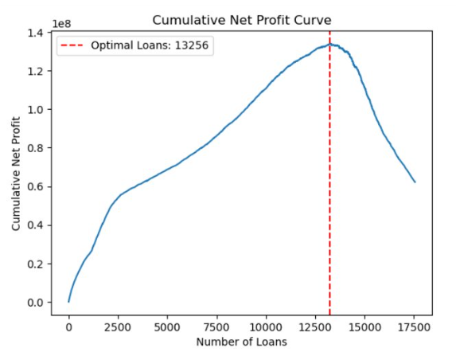
PROBABILITY OF SUCCESS FOR MAXIMUM CUMULATIVE PROFIT
Based on the cumulative net profit on the validation dataset
 | Results**
Optimal cutoff probability | 0.4056
Maximum cumulative profit | $134 MILLION
Optimal number of loans | 13,256
** Results may vary based on the validation dataset
TRAIN: 70,237
VALIDATION: 17,560

Slide 21
CATBOOST ON THE FULL DATASET
ROC-AUC : 0.9703
ACCURACY: 0.891
CONFUSION MATRIX
Based on the cumulative net profit on the validation dataset
PREDICTED
 | Paid in Full | Charged Off
Paid in Full | 200671 | 19900
Charged Off | 3414 | 43711
 | Results**
Maximum cumulative profit | $2.03 BILLION
Optimal number of loans | ~0.2 MILLION
ACTUAL
CLASSIFICATION REPORT
** Results may vary based on the validation dataset
 | Precision | Recall | F1-score | Support
0 | 0.98 | 0.91 | 0.95 | 220571
1 | 0.69 | 0.93 | 0.79 | 47125
TRAIN: 624,624
VALIDATION: 267,696

Slide 22
THANK YOU
TEAM CSUEB

